Slide 1
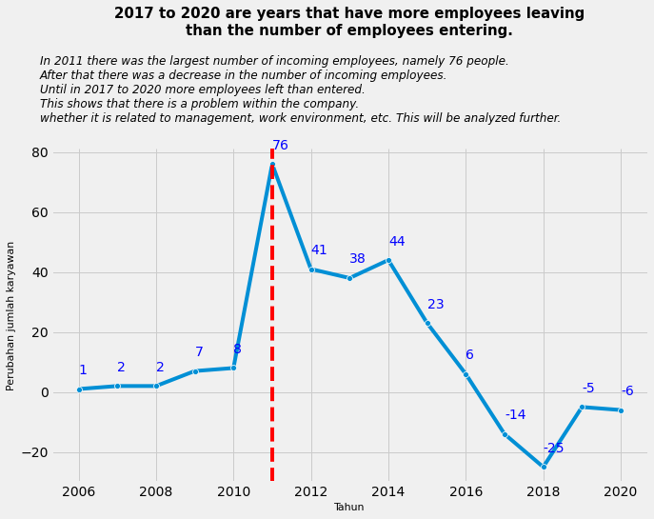
Annual Report on Employee Number Changes
According to the graph above, there was a decrease in the number of employees hired after 2011. The peak occurred in 2017 to 2020, the number of employees who left was more than employees who were accepted. This indicates that there is a problem within the company.
For more details, see jupyter notebook here

